Slide 1
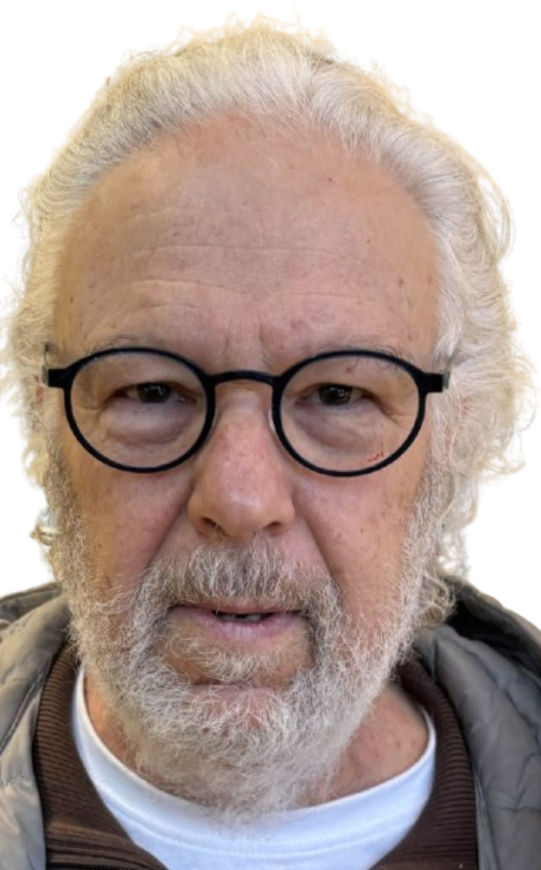
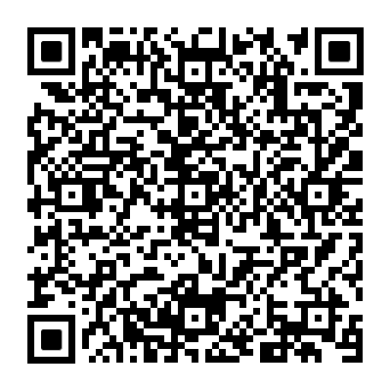


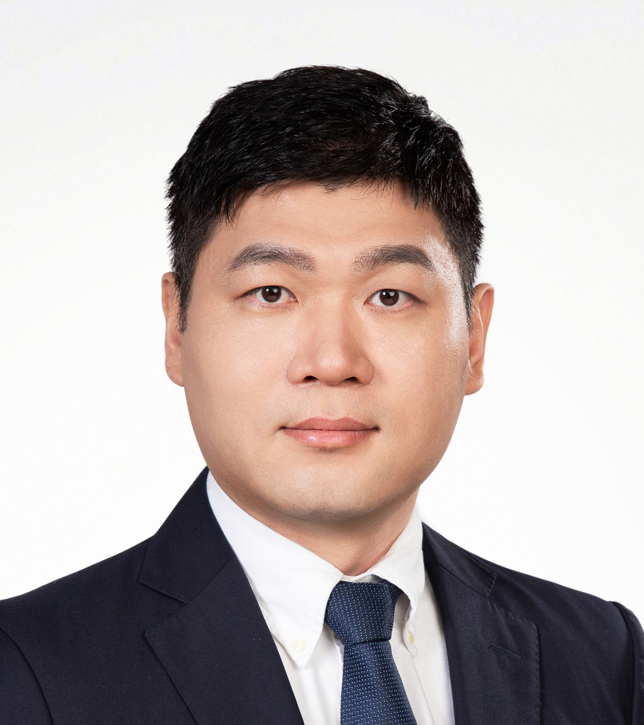


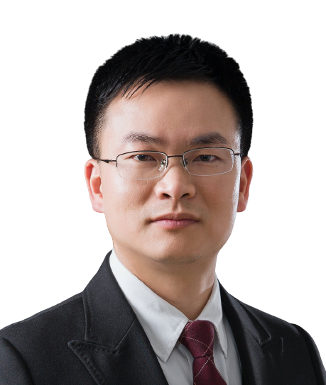
A system view of gene expression: cross talks among all stages of the mRNA life
Time (IST): 2025-02-17 10:00
Time (China): 2025-02-17 16:00
Zoom ID: 893 0005 4861
Passcode: 123456
Zoom meeting link: https://us06web.zoom.us/j/89300054861?pwd=TZbjJuSwrz4lTdg8yKCwDKKDDzqwNe.1
Bilibili：https://live.bilibili.com/26427894
Mordechai (Motti) Choder
Professor of biology, Technion – Israel Institute of Technology, Israel
Abstract:
Gene expression is traditionally viewed as a linear process divided into distinct stages. We have shown that this view is oversimplified. First, RNA polymerase II controls mRNA translation and decay via a mediator, Rpb4/7. Second, many transcripts are "tagged" with factors co-transcriptionally, one of these tags being Rpb4/7, which later regulate mRNA localization, translatability, and decay. We term this tagging "mRNA imprinting." Recently, we discovered that ~50 proteins bind Pol II transcripts co-transcriptionally, many of which likely affect mRNA fate. Remarkably, promoters, DNA elements known to control transcription, also regulate "mRNA imprinting," thereby influencing mRNA fate in the cytoplasm. Third, we found that the major mRNA 'decaysome', known for degrading mRNAs in the cytoplasm, also functions as a transcription activator by physically associating with chromatin. Significantly, the decaysome's ability to function in the synthesis of a particular mRNA in the nucleus depends on its capacity to complete degrading this mRNA in the cytoplasm. The underlying mechanism will be discussed in my talk. I will propose that some mRNA synthesis and decay factors represent a novel class of factors, "mRNA coordinators," which shuttle between all complexes controlling the mRNA lifecycle, integrating them into a system. I will show that Rpb4/7 carries >100 combinations of temporal post-translational modifications, which respond to the stage of the mRNA/Rpb4/7 complex (e.g., mRNA synthesis, translation, decay) and to the environment. We propose that these modifications are components of the language by which the various stages communicate and function as a system.
HOST＆PANELISTS
Host: Zhichao Miao
Guangzhou Laboratory
Guangzhou Medical University
Jinkai Wang
Sun Yat-sen University
Zongfu Wu
Nanjing Agricultural University
Lin Huang
Sun Yat-sen University
Sponsors

Slide 2
基因表达的系统视角：mRNA生命周期各阶段之间的相互作用
北京时间: 2025-02-17 16:00
Zoom 会议号: 893 0005 4861
密码: 123456
Zoom 会议链接: https://us06web.zoom.us/j/89300054861?pwd=TZbjJuSwrz4lTdg8yKCwDKKDDzqwNe.1
腾讯会议号： 743-101-048
B站：https://live.bilibili.com/26427894
Mordechai (Motti) Choder
生物学教授，以色列理工学院,，以色列
摘要：
基因表达传统上被视为一个线性过程，分为不同的阶段。我们已经证明这种观点过于简单化。首先，RNA聚合酶II通过介导因子Rpb4/7控制mRNA的翻译和降解。其次，许多转录本在转录过程中被“标记”，其中一个标记是Rpb4/7，后者随后调节mRNA的定位、可翻译性和降解。我们将这种标记称为“mRNA印记”。最近，我们发现约50种蛋白质在转录过程中与Pol II转录本结合，其中许多可能影响mRNA的命运。值得注意的是，已知控制转录的DNA元件（启动子）也调节“mRNA印记”，从而影响细胞质中mRNA的命运。第三，我们发现主要的mRNA“降解体”以降解细胞质中的mRNA而闻名，同时通过与染色质的物理结合也发挥转录激活因子的功能。重要的是，降解体在细胞核中合成特定mRNA的能力依赖于其在细胞质中完成该mRNA降解的能力。相关机制将在我的讲座中讨论。我将提出一些mRNA合成和降解因子代表一种新型因子类别，“mRNA协调因子”，它们在控制mRNA生命周期的所有复合物之间穿梭，将它们整合为一个系统。我将展示Rpb4/7携带超过100种时间性后转录修饰的组合，这些修饰响应于mRNA/Rpb4/7复合物的阶段（例如，mRNA合成、翻译、降解）以及环境。我们提出这些修饰是不同阶段之间沟通的语言的组成部分，并作为一个系统发挥功能。
主持人＆嘉宾
主持人：苗智超
广州实验室
广州医科大学
王金凯
中山大学
吴宗福
南京农业大学
黄林
中山大学
赞助商

